Slide 1
Copilot for Microsoft 365 - Real world use cases
Notes:
This presentation was automatically generated by PowerPoint Copilot based on content found in this document:

Slide 2
Agenda
Introduction
Top 5 Use Cases
Copilot in Microsoft Teams
Copilot in Microsoft Excel
Copilot in Microsoft Outlook
Copilot in Microsoft Word
Copilot in Microsoft PowerPoint
Cost of Copilot
Learn More About Copilot
Notes:
Agenda
* Introduction
* Top 5 Use Cases
* Copilot in Microsoft Teams
* Overview
* Reviewing Transcripts
* Teams Premium License
* Copilot in Microsoft Excel
* Overview
* Data Analysis
* Limitations
* Copilot in Microsoft Outlook
* Summarizing Email Chains
* Drafting Emails
* Searching Inbox
* Copilot in Microsoft Word
* Drafting Copy
* Referencing Files
* Copilot in Microsoft PowerPoint
* Cost of Copilot
* Learn More About Copilot

Slide 3

Introduction
Announced in March 2023, available to small and medium-sized businesses since February
  Integrates with business data across Microsoft 365 ecosystem
Resembles a more advanced Microsoft Clippy
  Can save time and improve productivity with new features and improvements
Notes:
Copilot for Microsoft 365 was announced in March 2023 and is available to small and medium-sized businesses. It integrates with business data across the Microsoft 365 ecosystem and resembles a more advanced Microsoft Clippy. It can save time and improve productivity with new features and improvements.
Original Content:
Copilot for Microsoft 365 - Real world use cases
Copilot for Microsoft 365 was announced back in March 2023, but has only been available to small and medium-sized businesses since February this year.
Anyone who has used AI chatbots such as ChatGPT will not be blown away by Copilots ability to converse and generate draft copy – but the true value of this product is its ability to integrate with your business data across the Microsoft 365 ecosystem.
When I first upgraded to Microsoft 365 for Copilot at the start of February (pricing information here), it might not be immediately obvious how helpful Copilot can be – and does resemble a more advance Microsoft Clippy (Microsoft’s discontinued paperclip office assistant). But after some days of using the system and some online research it has started saving me time and as Microsoft continues to release new features and improvements it could be a game changer for my productivity.

Slide 4
Top 5 Use Cases
Here are my 5 top use cases for Microsoft 365 for Copilot:
Notes:
Here are the top 5 use cases for Microsoft 365 for Copilot.
Original Content:
Here are my 5 top use cases for Microsoft 365 for Copilot:

Slide 5

Copilot in Microsoft Teams: Overview
Integration with Microsoft Teams
  Helps write agendas and research notes prior to important Teams meetings
  Draft messages to colleagues in chat
  Ask questions to Copilot and retrieve information from previous Teams conversations
Notes:
Copilot for Microsoft 365 has a useful integration with Microsoft Teams. It can help write agendas and research notes, draft messages to colleagues, and retrieve information from previous conversations.
Original Content:
Copilot in Microsoft Teams
One of the most useful features of Copilot for Microsoft 365 is its integration with Microsoft Teams. Copilot can help you in several ways when you use Teams, such as helping write agendas and research notes prior to important Teams meetings, draft messages to colleagues in chat or ask questions to Copilot and retrieve information from your previous Teams conversations:

Slide 6
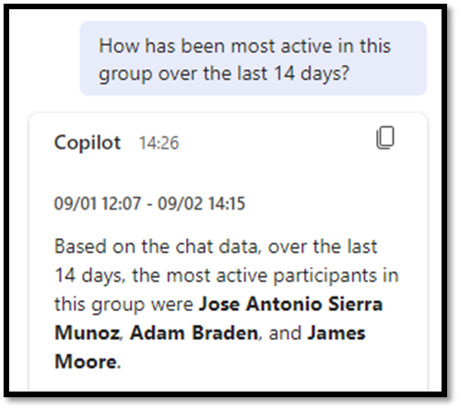
Copilot in Microsoft Teams: Reviewing Transcripts
Review transcripts of meetings and calls on the fly
  Ask Copilot to answer questions based on the call
  Provide actionable items at the end of the call
Notes:
Copilot for Microsoft Teams has a useful feature that allows you to review transcripts of meetings and calls on the fly. You can ask Copilot to answer questions based on the call and provide actionable items at the end of the call.
Original Content:
But the most useful feature I found in Copilot for Microsoft teams was the ability to review transcripts of meetings and calls on the fly. This means, midway through a meeting you can ask Copilot to answer questions based on the call. You can also ask it to provide actionable items at the end of the call like so:

Slide 7
Copilot in Microsoft Teams: Teams Premium License
Most features available in both Microsoft Teams Premium and Copilot for Microsoft 365
  Microsoft Teams Premium is cheaper than Copilot for Microsoft 365
Notes:
Most features are available in both Microsoft Teams Premium and Copilot for Microsoft 365. However, Microsoft Teams Premium is cheaper than Copilot for Microsoft 365.
Original Content:
Most of these features are also available in the Microsoft Teams Premium licence which is cheaper than the full Copilot for Microsoft 365.

Slide 8

Copilot in Microsoft Excel: Overview
Interact with Excel
  Highlight, sort and analyse data
  Add additional columns with new formulas
Notes:
Copilot can interact with Excel to highlight, sort, and analyze data. You can even ask it to add additional columns with new formulas.
Original Content:
Copilot in Microsoft Excel
The only feature on my list which is still technically in preview as of the time writing, is copilots ability to interact with Excel. You can ask it to highlight, sort and analyse data from your excel dataset. You can even ask it to add additional columns with new formulas.

Slide 9
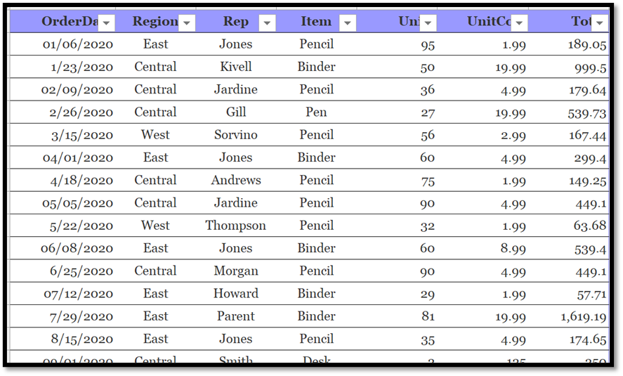
Copilot in Microsoft Excel: Data Analysis
I can query the data, asking Copilot to find the sales rep with the most sales:
Notes:
This slide discusses querying data to find the sales rep with the most sales.
Original Content:
I can query the data, asking Copilot to find the sales rep with the most sales:

Slide 10
Copilot in Microsoft Excel: Limitations
Current Limitations
  Data must be saved to SharePoint
  Data must be in a table inside Excel
Notes:
Please note that currently, your data must be saved to SharePoint and be in a table inside Excel for this to work.
Original Content:
Please note – this currently only works if your data is saved to SharePoint and is in a table inside excel.

Slide 11
Copilot in Microsoft Outlook: Summarizing Email Chains
Quickly summarize long email chains
  Find important information easily
Notes:
Copilot for Microsoft Outlook offers the advantage of quickly summarizing long email chains, making it easier to find important information.
Original Content:
Copilot in Microsoft Outlook –
The most immediate advantage of using Copilot for Microsoft Outlook is the ability to quickly summarise long email chains. I find this particularly useful as I am often forwarded emails in which I Have to scroll through multiple emails in the conversation to find the important information.
Here is an example of me using the summarise feature:

Slide 12

Copilot in Microsoft Outlook: Drafting Emails
Use Copilot to draft new emails
  Helps to save time and effort
Search inbox based on intent and actionable items
  More efficient than searching for keywords
Access these features through Copilot web portal
  Easy and convenient to use
Notes:
With Copilot, you can easily draft new emails and search your inbox based on intent and actionable items. This is more efficient than searching for keywords. You can access these features through the Copilot web portal.
Original Content:
Its also very helpful to use Copilot to help draft new emails and like in Teams you can search through your inbox to find emails based on intent and actionable items instead of searching for keywords. You can do this from the Copilot web portal like this:

Slide 13
Copilot in Microsoft Outlook: Searching Inbox
Copilot in Microsoft Word –
Notes:
This slide is about Copilot in Microsoft Word.
Original Content:
Copilot in Microsoft Word –

Slide 14

Copilot in Microsoft Word: Drafting Copy
Ability to draft copy
  Quicker and easier than using ChatGPT
  Already has the context of the document
Notes:
Copilot provides the advantage of drafting copy within a word document, making it quicker and easier than using ChatGPT. It already has the context of the document, making the process more efficient.
Original Content:
The obvious advantage of having Copilot available in your word document is the ability to have it draft copy for you. I found this to be quicker and easier than using ChatGPT as it already has the context of the document I’m working in when creating new copy. For example, here is Copilot finishing this paragraph for me:

Slide 15
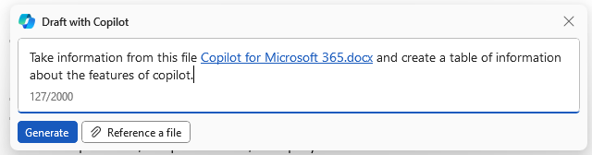
Copilot in Microsoft Word: Referencing Files
Referencing other files in Copilot
  Currently only accepts Microsoft Word files
  Expansion to other file types expected in the future
Notes:
You can reference other files when using Copilot in Word. Currently, it only accepts other Microsoft Word files, but this is expected to expand in the future.
Original Content:
You can also refer to other files when speaking with Copilot in Word. Currently, it only accepts other Microsoft word files as references, but this is sure to expand over time. Like this:

Slide 16
Copilot in Microsoft PowerPoint
Copilot in PowerPoint can draft copy in the same way as Word
  This speeds up the process of drafting new slide decks
Copilot can convert word documents into PowerPoint presentations
  See the link to see the presentation Copilot automatically generated
Notes:
Copilot in PowerPoint can draft copy in the same way as Word, speeding up the process of drafting new slide decks. It can also convert word documents into PowerPoint presentations. Check out the link to see the presentation Copilot automatically generated.
Original Content:
Copilot in Microsoft PowerPoint –
As well as being able to draft copy in the same way as Word, which by itself already speeds up the process of drafting new slide decks. Copilot in PowerPoint has the impressive ability to convert word documents into PowerPoint presentations.
See this link to see the presentation Copilot automatically generated from word document I am using to draft this blog post.

Slide 17
Cost of Copilot
Plan Type | Cost (EX VAT) | Per User
Annual Pre-Paid | £296.40 | Yes
Annual pre-paid plan
  Costs £296.40 EX VAT per user
Each user needs their own license
Notes:
Copilot for Microsoft 365 is available on an annual pre-paid plan, costing £296.40 EX VAT per user. Each user who needs to interact with Copilot will require their own license.
Original Content:
How much does Copilot cost?
Copilot for Microsoft 365 is currently only available on an annual pre-paid plan costing £296.40 EX VAT. This is a per user price, every user who needs to interact with Copilot will require their own licence.

Slide 18

Learn More About Copilot
Join our free webinar to learn more about Copilot for Microsoft 365
  Boost your business productivity
  Live demonstration of Copilot's features and capabilities
Register on our website and fill out the form
  Receive a confirmation email with the details of the webinar
  Date, time, and link included
We look forward to seeing you there!
Notes:
Join our free webinar to learn more about Copilot for Microsoft 365 and how it can boost your business productivity. Register on our website and receive a confirmation email with the details. We look forward to seeing you there!
Original Content:
How can you learn more about Copilot?
If you are interested in learning more about Copilot for Microsoft 365, and how it can help you boost your business productivity, you are invited to join our free webinar, where we will answer your questions and show you a live demonstration of Copilot's features and capabilities. To register for the webinar, please visit our website and fill out the form. You will receive a confirmation email with the details of the webinar, including the date, time, and link. We look forward to seeing you there!

